Slide 1

Lecture 4 Functions
Computer Engineering/Basic Computer Engineering

Slide 2
Introduction
A function is a block of code that performs a specific task.
Suppose, you need to create a program to create a circle and color it.
You can create two functions to solve this problem:
1. create a circle function
2.create a color function
Dividing a complex problem into smaller chunks makes our program easy to understand and reuse.
You can divide up your code into separate functions. How you divide up your code among different functions is up to you, but logically the division is such that each function performs a specific task.

Slide 3
Types of Functions
Types of Functions
Standard Library Functions
User-Defined Functions

Slide 4
Standard Library Functions
Standard Library Functions
Standard library functions are also known as built-in functions.
Functions such as puts(), gets(), printf(), scanf() etc are standard library functions.
These functions are already defined in header files (files with .h extensions are called header files such as stdio.h), so we just call them whenever there is a need to use them.
For example, the printf() function is a standard library function to send formatted output to the screen (display output on the screen). This function is defined in the stdio.h header file.
Hence, to use the printf() function, we need to include the stdio.h header file using #include <stdio.h>.
The sqrt() function calculates the square root of a number. The function is defined in the math.h header file.

Slide 5
User Defined Functions
2) User Defined Functions
The functions that we create in a program are known as user defined functions or in other words you can say that a function created by user is known as user defined function.
Whereas a user-defined function is a type of function in which we have to write a body of a function and call the function whenever we require the function to perform some operation in our program.
A user-defined function in C is always written by the user, but later it can be a part of ‘C’ library. It is a major advantage of ‘C’ programming.

Slide 6
User Defined Functions
User Defined Functions
A function is a block of code that performs a specific task.
C allows you to define functions according to your need. These functions are known as user-defined functions.
For example:
Suppose, you need to create a circle and color it depending upon the radius and color. You can create two functions to solve this problem:
createCircle() function
color() function

Slide 7
How user defined functions works ?
#include <stdio.h>
void functionName()
{
... .. ...
... .. ...
}
int main()
{
... .. ...
... .. ...
functionName();
... .. ...
... .. ...
}
The execution of a C program begins from the main() function.
When the compiler encounters functionName();,
control of the program jumps to
void functionName()
And, the compiler starts executing the codes inside functionName().
The control of the program jumps back to the main() function once code inside the function definition is executed.

Slide 8
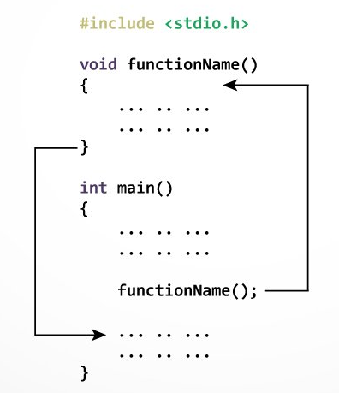
How functions works?

Slide 9
Example: User Defined Functions
Here is an example to add two integers. To perform this task, we have created a user-defined addNumbers().
#include <stdio.h>
int addNumbers(int a, int b); // function prototype
int main()
{
int n1,n2,sum;
printf("Enters two numbers: ");
scanf("%d %d",&n1,&n2);
sum = addNumbers(n1, n2); // function call
printf("sum = %d",sum);
return 0;
}
int addNumbers(int a, int b)
// function definition
{
int result;
result = a+b;
return result; // return statement
}

Slide 10
Functions
C programming functions are divided into three activities such as:
1. Function Declaration
2. Function Call
3. Function Definition

Slide 11
Function Declaration
Function declaration means writing a name of a program. It is a compulsory part for using functions in code.
In a function declaration, we just specify the name of a function that we are going to use in our program like a variable declaration.
We cannot use a function unless it is declared in a program.
A function declaration is also called “Function Prototype.” The function declarations (called prototype) are usually done above the main () function and take the general form.

Slide 12
Function Declaration
Syntax of function prototype
The return_data_type: is the data type of the value function returned back to the calling statement.
The function_name: is followed by parentheses
Arguments names with their data type declarations optionally are placed inside the parentheses.
returnType functionName(type1 argument1, type2 argument2, ...);
return_data_type function_name (data_type arguments);

Slide 13
Function Declaration
In the above example, int addNumbers(int a, int b); is the function prototype which provides the following information to the compiler:
name of the function is addNumbers()
return type of the function is int
two arguments of type int are passed to the function
The function prototype is not needed if the user-defined function is defined before the main() function.
#include <stdio.h>
int addNumbers(int a, int b); // function prototype

Slide 14
Function Call
Control of the program is transferred to the user-defined function by calling it.
A function call means calling a function whenever it is required in a program. Whenever we call a function, it performs an operation for which it was designed. A function call is an optional part of a program.
Syntax of function call
In the above example (slide 13), the function call is made using addNumbers(n1, n2); statement inside the main() function.
functionName(argument1, argument2, ...);

Slide 15
Function Call
result = add(4,5);
Here, is the complete code:
#include <stdio.h>
int add(int a, int b); //function declaration
int main()
{
int a=10,b=20;
int c=add(10,20); //function call
printf("Addition:%d\n",c);
getch();
}
int add(int a, int b) //function body
{
int c;
c=a+b;
return c;
}
Output:
Addition:30

Slide 16
Function Definition
Function definition means just writing the body of a function. A body of a function consists of statements which are going to perform a specific task. A function body consists of a single or a block of statements. It is also a mandatory part of a function.
Function definition contains the block of code to perform a specific task. In our example, adding two numbers and returning it.

Slide 17
Function Definition
Syntax of function definition
When a function is called, the control of the program is transferred to the function definition and the compiler starts executing the codes inside the body of a function.
returnType functionName(type1 argument1, type2 argument2, ...)
{
//body of the function
}
int add(int a,int b) //function body
{
int c;
c=a+b;
return c;
}

Slide 18
Function Arguments
A function’s arguments are used to receive the necessary values by the function call.
They are matched by position; the first argument is passed to the first parameter, the second to the second parameter and so on.
By default, the arguments are passed by value in which a copy of data is given to the called function. The actually passed variable will not change.

Slide 19
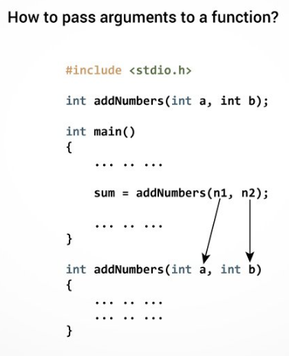
Function Arguments

Slide 20
Function Arguments
We consider the following program which demonstrates parameters passed by value:
int add (int x, int y);
int main()
{
int a, b, result;
a = 5;
b = 10;
result = add(a, b);
printf("%d + %d\ = %d\n", a, b, result);
return 0;}
int add (int x, int y) {
x += y;
return(x);
}

Slide 21
Function Arguments
The program output is:
5 + 10 = 15
Keep in mind that the values of a and b were passed to add function were not changed because only its value was passed into the parameter x.

Slide 22
Return Statement
The return statement terminates the execution of a function and returns a value to the calling function.
The program control is transferred to the calling function after the return statement.
In the above example, the value of the result variable is returned to the main function.
The sum variable in the main() function is assigned this value.

Slide 23
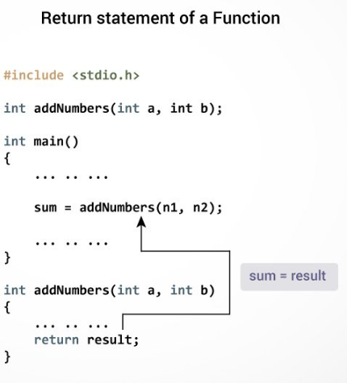
Return Statement

Slide 24
Return Statement
Syntax of return statement
For example,
The type of value returned from the function and the return type specified in the function prototype and function definition must match.
return (expression);
return a;
Return (a+b);

Slide 25
Types of User Defined Function
Depending on whether arguments are present or not and whether a value is returned
or not, functions are categorized into −
1. Functions without arguments and without return values
2. Functions without arguments and with return values
3. Functions with arguments and without return values
4. Functions with arguments and with return values

Slide 26
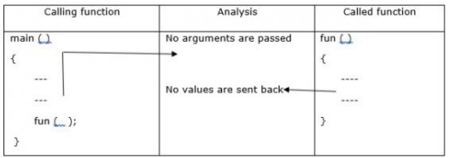
Types of User Defined Function
Functions without arguments and without return values
(No argument passed & No return value)

Slide 27
Types of User Defined Function
Functions without arguments and without return values
#include<stdio.h>
void sum ()
{
int a,b,c;
printf("Enter 2 numbers:");
scanf ("%d, %d", &a, &b);
c = a+b;
printf("sum = %d",c);
}
Void main ()
{
sum ();
}
Output
Enter 2 numbers: 3,5
Sum=8

Slide 28
Types of User Defined Function
Functions without arguments and without return values
#include <stdio.h>
void checkPrimeNumber();
int main()
{
checkPrimeNumber(); // argument is not passed
return 0;
}
// return type is void meaning doesn't return any value
void checkPrimeNumber()
{
int n, i, flag = 0;
printf("Enter a positive integer: ");
scanf("%d",&n);
// 0 and 1 are not prime numbers
if (n == 0 || n == 1)
flag = 1;
for(i = 2; i <= n/2; ++i)
{
if(n%i == 0)
{
flag = 1;
break;
}
}
if (flag == 1)
printf("%d is not a prime number.", n);
Else
printf("%d is a prime number.", n);
}
Notes:
The checkPrimeNumber() function takes input from the user, checks whether it is a prime number or not, and displays it on the screen.
The empty parentheses in checkPrimeNumber(); inside the main() function indicates that no argument is passed to the function.
The return type of the function is void. Hence, no value is returned from the function.

Slide 29
Types of User Defined Function
2. Functions without arguments and with return values
(No argument passed but return a value)

Slide 30
Types of User Defined Function
Functions without arguments and with return values
#include<stdio.h>
int sum ()
{
int a,b,c;
printf(“Enter 2 numbers:”);
scanf (“%d, %d”, &a, &b);
c = a+b;
return c;
}
Void main ()
{
int c;
c= sum ();
printf(“sum = %d”,c);
}
Output
Enter two numbers: 10, 20
Sum= 30

Slide 31
Types of User Defined Function
Functions without arguments and without return values
#include <stdio.h>
int getInteger();
int main() {
int n, i, flag = 0; // no argument is passed
n = getInteger();
// 0 and 1 are not prime numbers
if (n == 0 || n == 1)
flag = 1;
for(i = 2; i <= n/2; ++i) {
if(n%i == 0){
flag = 1;
break;
}
}
if (flag == 1)
printf("%d is not a prime number.", n);
else
printf("%d is a prime number.", n);
return 0;
}
// returns integer entered by the user
int getInteger() {
int n;
printf("Enter a positive integer: ");
scanf("%d",&n);
return n;
}
Notes:
The empty parentheses in the n = getInteger(); statement indicates that no argument is passed to the function.
And, the value returned from the function is assigned to n.
Here, the getInteger() function takes input from the user and returns it. The code to check whether a number is prime or not is inside the main() function.

Slide 32
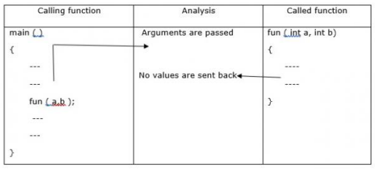
Types of User Defined Function
3. Functions with arguments and without return values
(Argument passed but no return value)

Slide 33
Types of User Defined Function
Functions with arguments and without return values
#include<stdio.h>
void sum (int a, int b)
{
int c;
c= a+b;
printf (“sum=%d”, c);
}
Void main ()
{
int a,b;
printf("Enter 2 numbers:");
scanf("%d, %d", &a,&b);
sum (a,b);
}
Output
Enter two numbers: 10, 20
Sum=30

Slide 34
Types of User Defined Function
Functions with arguments and without return values
#include <stdio.h>
void checkPrimeAndDisplay(int n);
int main() {
int n;
printf("Enter a positive integer: ");
scanf("%d",&n);
// n is passed to the function
checkPrimeAndDisplay(n);
return 0;
}
// return type is void meaning doesn't return any value
void checkPrimeAndDisplay(int n) {
int i, flag = 0;
// 0 and 1 are not prime numbers
if (n == 0 || n == 1)
flag = 1;
for(i = 2; i <= n/2; ++i) {
if(n%i == 0){
flag = 1;
break;
}
}
if(flag == 1)
printf("%d is not a prime number.",n);
else
printf("%d is a prime number.", n);
}
Notes:
The integer value entered by the user is passed to the checkPrimeAndDisplay() function.
Here, the checkPrimeAndDisplay() function checks whether the argument passed is a prime number or not and displays the appropriate message.

Slide 35
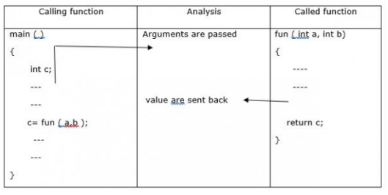
Types of User Defined Function
4. Functions with arguments and with return values
(Argument passed but return a value)

Slide 36
Types of User Defined Function
Functions with arguments and with return values
#include<stdio.h>
int sum ( int a, int b )
{
int c;
c= a+b;
return c;
}
Void main ()
{
int a,b,c;
printf("Enter 2 numbers:");
scanf("%d, %d", &a,&b);
c= sum (a,b);
printf ("sum=%d", c);
}
Output
Enter two numbers: 10, 20
Sum=30

Slide 37
Types of User Defined Function
Functions with arguments and with return values
#include <stdio.h>
int checkPrimeNumber(int n);
int main() {
int n, flag;
printf("Enter a positive integer: ");
scanf("%d",&n);
// n is passed to the checkPrimeNumber() function
// the returned value is assigned to the flag variable
flag = checkPrimeNumber(n);
if(flag == 1)
printf("%d is not a prime number",n);
else
printf("%d is a prime number",n);
return 0;
}
// int is returned from the function
int checkPrimeNumber(int n) {
// 0 and 1 are not prime numbers
if (n == 0 || n == 1)
return 1;
int i;
for(i=2; i <= n/2; ++i) {
if(n%i == 0)
return 1;
}
return 0;
}

Slide 38
Variable Scope
Variable scope means the visibility of variables within a code of the program.
In C, variables which are declared inside a function are local to that block of code and cannot be referred to outside the function. However, variables which are declared outside all functions are global and accessible from the entire program.
Constants declared with a #define at the top of a program are accessible from the entire program. We consider the following program which prints the value of the global variable from both main and user defined function:

Slide 39
Variable Scope
#include <stdio.h>
int global = 1348;
void test();
int main() {
printf("from the main function : global =%d \n", global);
test () ;
return 0;}
void test (){
printf("from user defined function : global =%d \n", global);}
Output:
from the main function : global =1348 from user defined function : global =1348

Slide 40
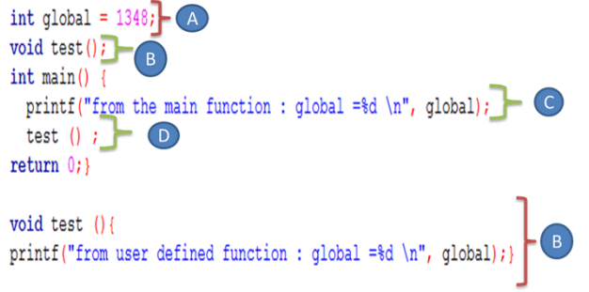
Variable Scope
We discuss the program details:
A. We declare an integer global variable with 1348 as initial value.
B. We declare and define a test() function which neither takes arguments nor
returns a value. This function only prints the global variable value to
demonstrate that the global variables can be accessed anywhere in the
program.
C. We print the global variable within the main function.
D. We call the test function in order to print the global variable value.

Slide 41
Variable Scope
In C, when arguments are passed to function parameters, the parameters act as local variables which will be destroyed when exiting the function. When you use global variables, use them with caution because can lead to errors and they can change anywhere in a program. They should be initialized before using

Slide 42
Static Variable
The static variables have a local scope. However, they are not destroyed when exiting the function. Therefore, a static variable retains its value forever and can be accessed when the function is re-entered. A static variable is initialized when declared and needs the prefix static.

Slide 43
Recursive Functions
Consider the factorial of a number which is calculated as follow 6! =6* 5 * 4 * 3 * 2 * 1.
This calculation is done as repeatedly calculating fact * (fact -1) until fact equals 1.
A recursive function is a function which calls itself and includes an exit condition in order to finish the recursive calls. In the case of the factorial number calculation, the exit condition is fact equals to 1. Recursion works by “stacking” calls until the exiting condition is true.

Slide 44
Recursive Functions
#include <stdio.h>
int factorial(int number);
int main() {
int x = 6;
printf("The factorial of %d is %d\n", x, factorial(x));
return 0;}
int factorial(int number) {
if (number == 1) return (1); /* exiting condition */
else
return (number * factorial(number - 1));
}
Output:
The factorial of 6 is 720

Slide 45
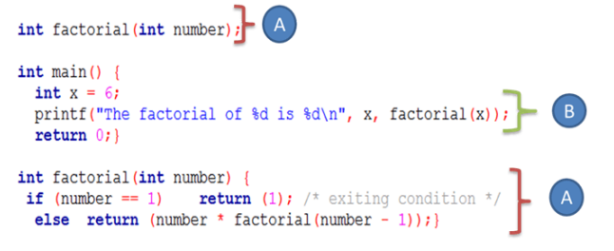
Recursive Functions
We declare our recursive factorial function which takes an integer parameter and returns the factorial of this parameter. This function will call itself and decrease the number until the exiting, or the base condition is reached. When the condition is true, the previously generated values will be multiplied by each other, and the final factorial value is returned.
We declare and initialize an integer variable with value”6″ and then print its factorial value by calling our factorial function.

Slide 46
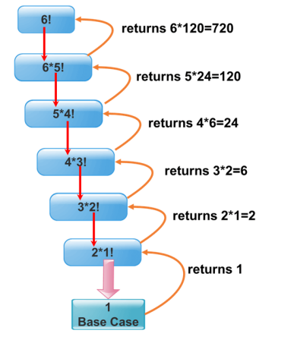
Recursive Functions
Consider the following chart to more understand the recursive mechanism which consists of calling the function itself until the base case or stopping condition is reached, and after that, we collect the previous values

